Slide 1
Internal Assessment-1
Excel

Slide 2
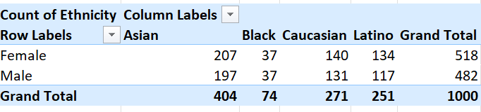
Task 1
Observing the data devised regarding the gender and ethnic diversity within the company, it is clear that Asian people are larger in number followed by Caucasian origin in both male and female while people from black origin have the least number.

Slide 3
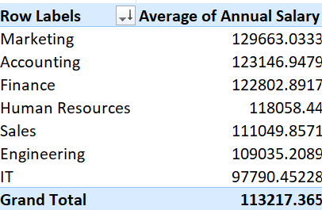
Task 3
Calculating the average of salaries per department, we can conclude that the Marketing department has the highest average salary of 129663.0333 whereas the IT department has the least average salary of 97790.45228.
On that note, it is worth noting that the difference between both department amounts to roughly 30000. There is a difference between the average salaries in departments but not a significant one.

Slide 4
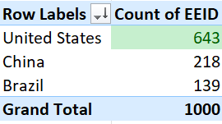
Task 4
While the company has employees only from the countries of United States, China and Brazil, the number of employees from the United States are significantly higher compared to the other two.
The employees who hail from the United States are 643 in number out of 1000.

Slide 5
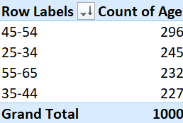
Task 5
Observing the data, the youngest employee in the company is 25 and the oldest employee is 54. By grouping them to a range of 10, the common age range of employees is observed.
The age range of 45-54 is the most common while the age range of 35-44 is the least common.

Slide 6

Task 6
The average of bonus given to all 1000 employees working within the company amounts to 9%.
But it is worth noting that not all employees within the company received a bonus. The average is derived from taking into account even the employees who didn’t receive a bonus.

Slide 7
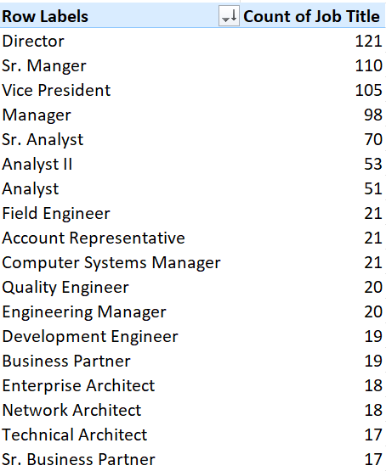
Task 7
The job title that occurs the most frequently in the given dataset is Director with a total of 121 employees with that title across different departments.

Slide 8
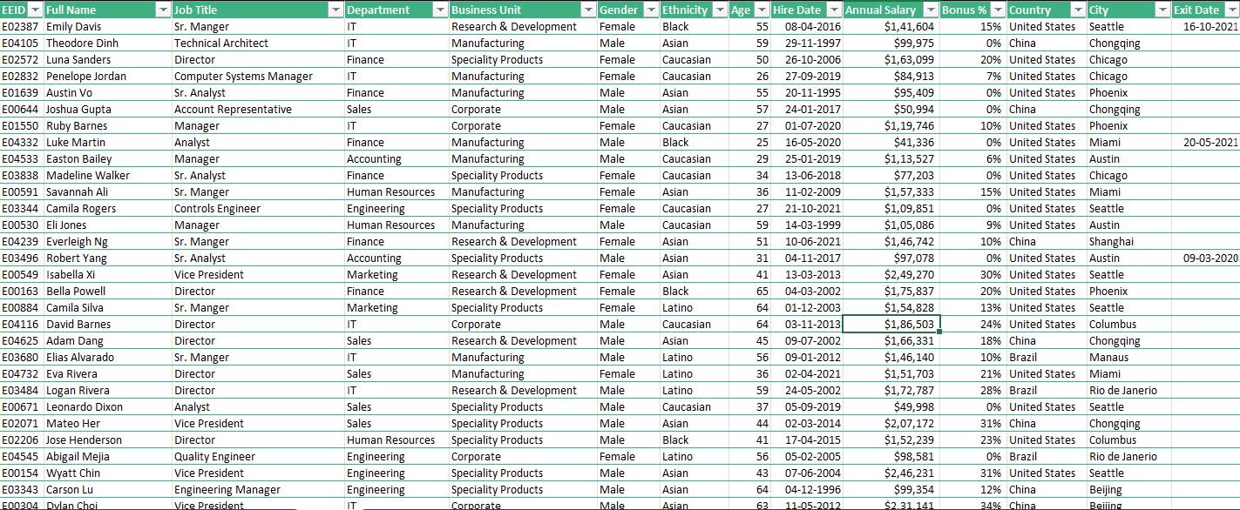
Task 8
There is no data given regarding the reasons for the employees’ departure from the company in the given dataset.

Slide 9
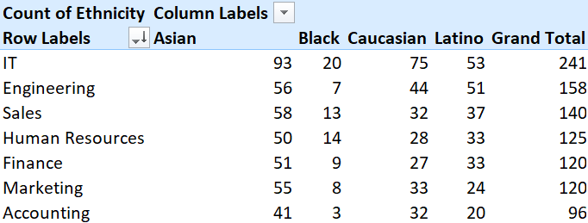
Task 9
Yes, certain department are more varied in ethnicity compared to other departments.
IT department is the most diverse whereas Accounting department is the least diverse.

Slide 10
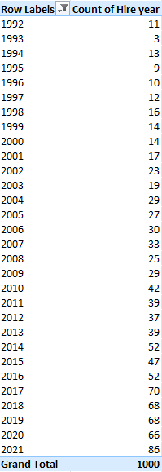
Task 10
Observing the dataset, overall there has been an increase in the hires over the years. While there was a decrease after the year 2017, the hiring has picked up again after 2020

